Slide 1
Coursera Data Science Capstone PROJECT
Clustering Neighborhoods in Canada

Slide 2
introduction
Canada has one of the highest immigration rates in the world
In 2019 alone it welcomed 341,000 new immigrants
Additional 400,000 to be accepted per year between 2021-2023
In this project we will create a tool to assist new Canadian immigrants Canada to quickly find neighborhood which best suits them

Slide 3
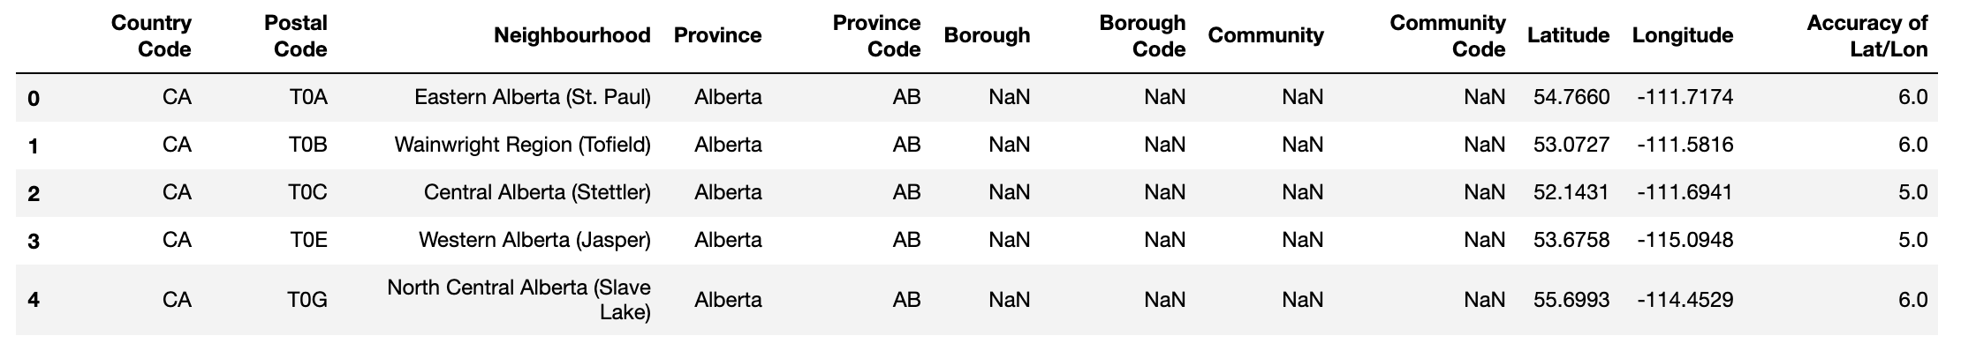
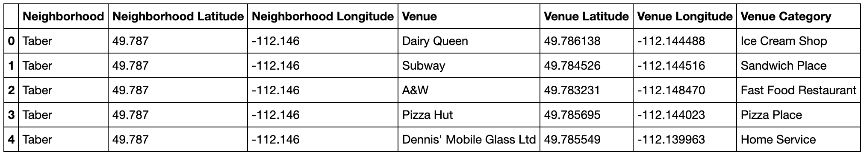
Data
Location data
Following datasets are used:
Location data of major neighborhoods in Canada. data source: http://download.geonames.org/export/zip/
Popular venues in neighborhood using Foursquare APIs
Venue data

Slide 4
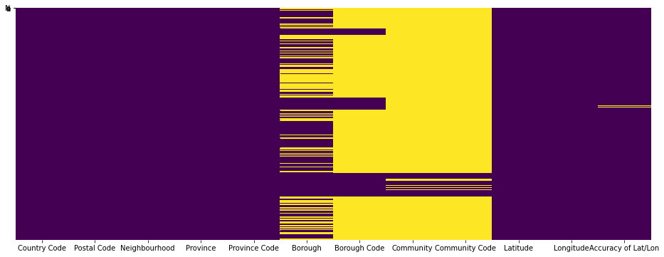
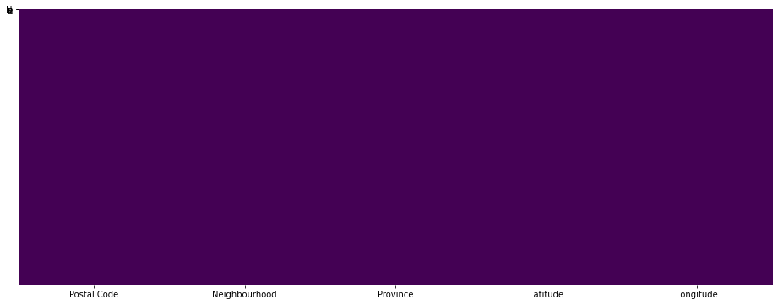
Data Wrangling and Cleaning
Original Dataset (size 1656,12 )
Data cleaning involved the following steps:
Checking for missing values
Identifying and dropping irrelevant columns
Dropping rows with missing values
Cleaned Dataset (size 1656,6 )
*Yellow cells in plots represent missing values

Slide 5
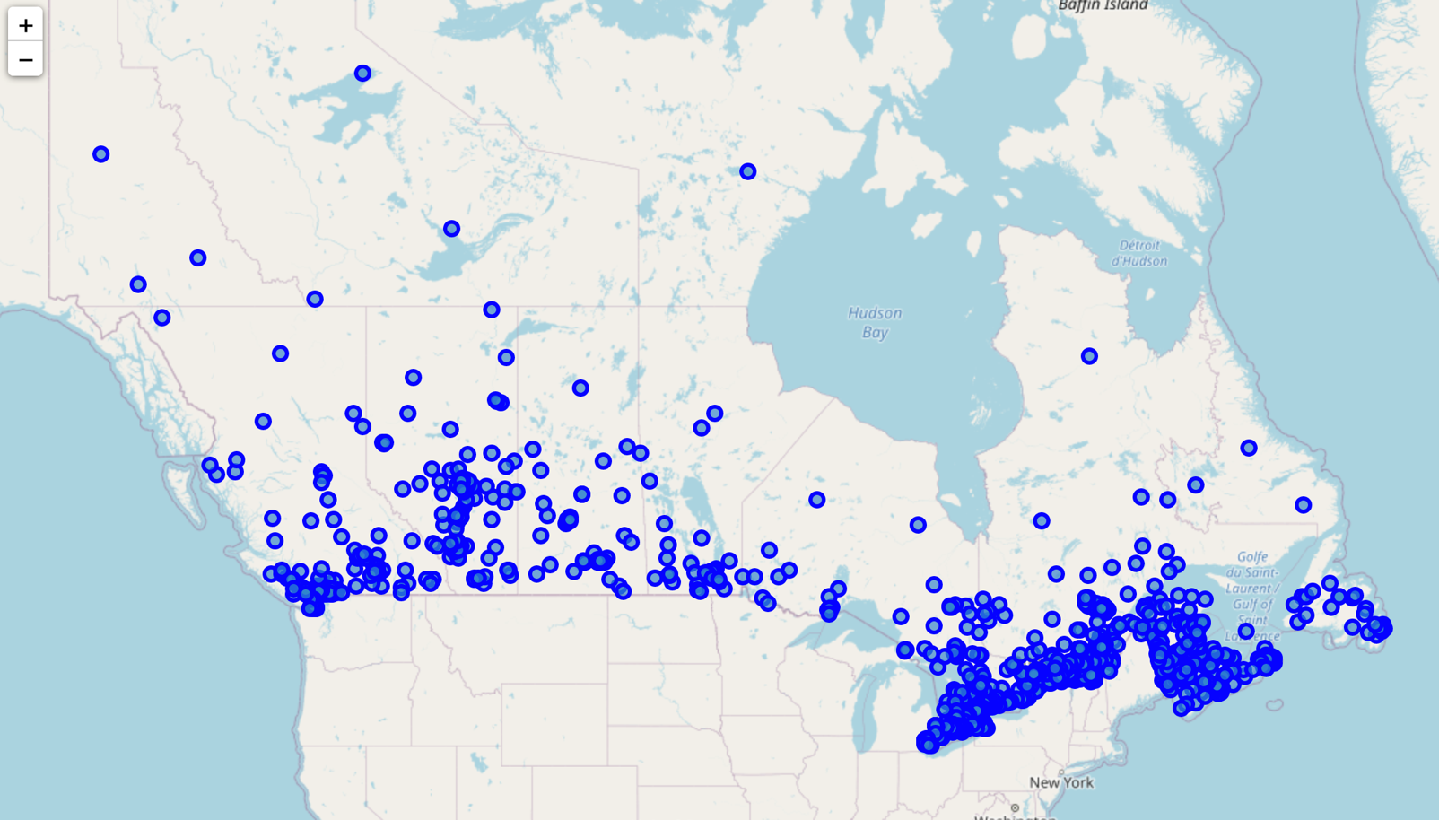
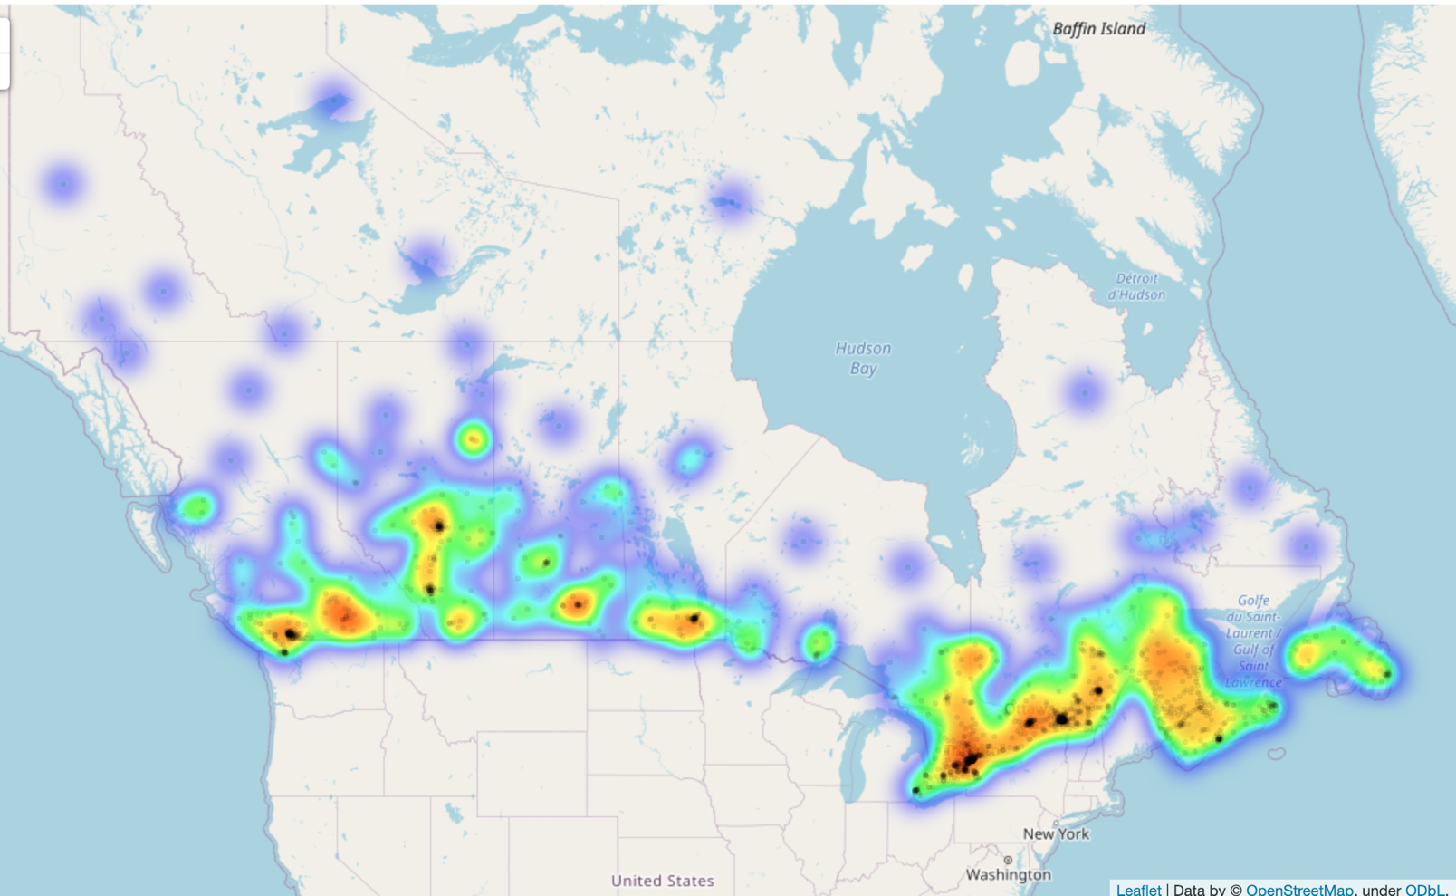
Exploratory Data Analysis
Most popular neighborhoods populated closer to the US border.
Sparsely populated neighborhoods in North
From the density of black point on heat map we could easily identify the major cities form West to East such as Vancouver, Calgary, Edmonton, Toronto, Ottawa, Montreal, Halifax.
Neighborhoods plotted as points on map
Heatmap showing density of populated neighborhoods plotted

Slide 6
K-Means Clustering Workflow
Remove all neighborhoods which have less than 5 venues in vicinity. We are doing this to remove isolated neighborhoods and this way the clusters we create will be more meaningful for someone to examine and make relocation decisions
One hot encode all categorical features
Group rows per neighborhood by taking the mean of the frequency of occurrence of each venue category
Filter top 5 venues for each neighborhood
Run k-means clustering for different cluster values and pick the optimum using elbow method
Run final clustering on the optimum cluster value picked from the elbow method.

Slide 7
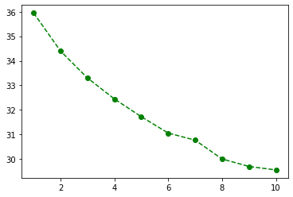
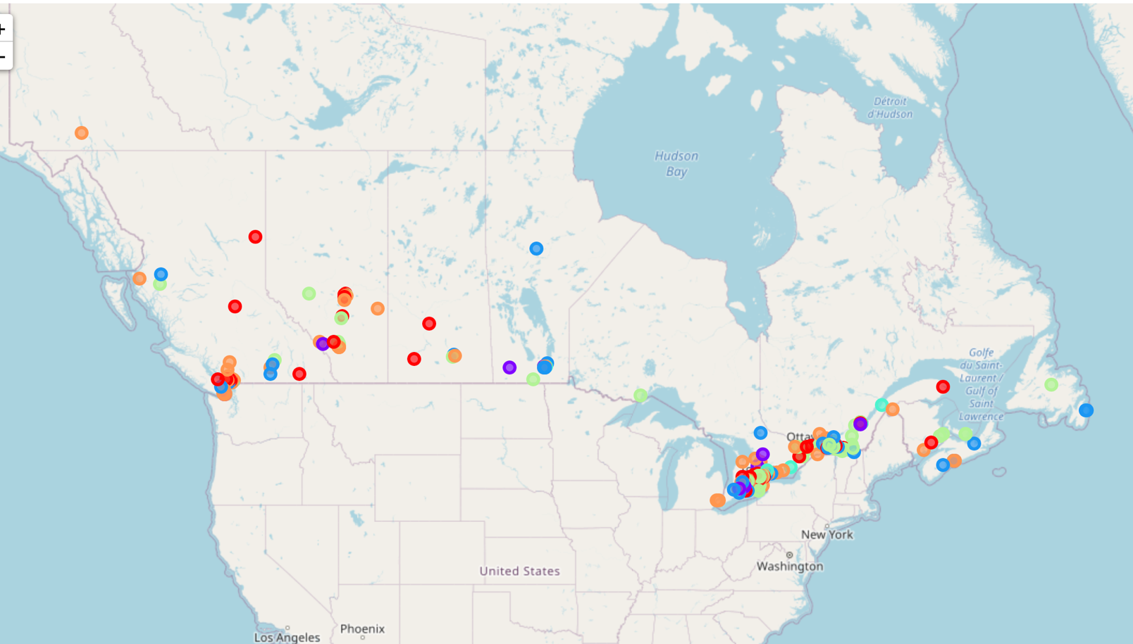
Results
Elbow Method to choose optimum k value
Error
Error decreases with an increasing number of clusters.
However, each additional cluster provides a smaller net benefit.
After k=6 the drop in error becomes small, so we pick 6 as our number of optimum clusters and re-run k-mean with it.
Different clusters generate and their respective locations are shown on the map
k
Clusters of popular neighborhoods in Canada

Slide 8
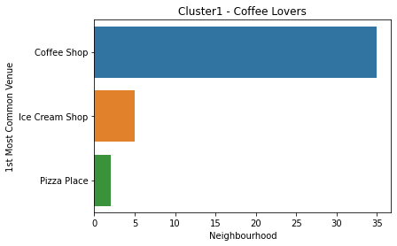
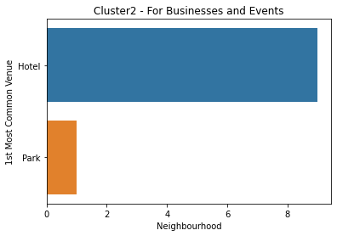
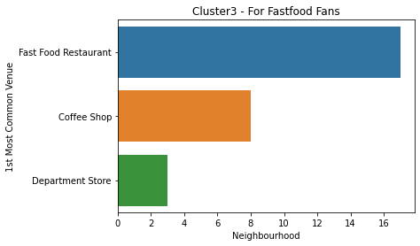
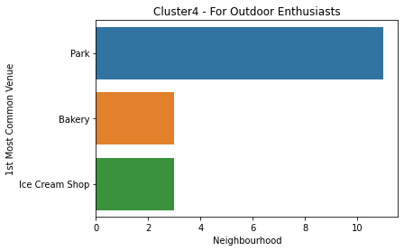
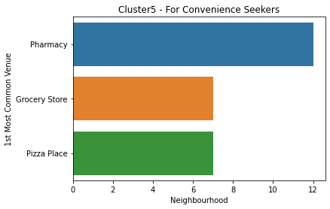
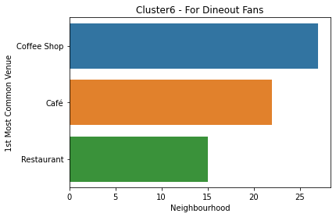
Discussion
We plot most common venue in each cluster on the right
Based on these trends we can verbally describe clusters as follows:
Cluster 1: Neighborhood popular with people who love coffee
Cluster 2: Neighborhood with a lot of Hotels around, good for businesses and events
Cluster 3: Neighborhood popular with people who prefer Fast food
Cluster 4: Neighborhood popular with people who enjoy outdoors
Cluster 5: Neighborhood with Pharmacies and Grocery store around for those who prefer convenience
Cluster 6: Cluster 6 is somehow similar to Cluster 1, but also features Cafes and Restaurants

Slide 9
Conclusion
We were able to leverage huge amount of data and information to visualize and understand habitable and popular neighborhoods.
Next, we segmented the neighborhoods into different clusters so that the immigrants can drill down into the region of their choice and choose the neighborhood which best suits their taste.
We were able to identify 6 distinct neighborhood type and we also verbally named them based on the popular venues.
With this application we are now able to facilitate anyone looking for a place to relocate.

